Slide 1


Molecular dynamics analysis libraries with an example based on the dynamics in the physiopathology of gelsolin
Toni Giorgino toni.giorgino@cnr.it
www.giorginolab.it
@giorginolab
github.com/giorginolab/GSN-Tutorial-BCN-2022
Master projects available!
MSI - Master in Bioinformatics for Health Sciences @ UPF 28/4/2022
Notes:
1

Slide 2

Part 1. Motivation Finnish-type amyloidogenic gelsolin variant -
an example of protein dynamics playing a role in proteotoxicity and drug design discovered by MD.
Part II. Practice
MD analysis libraries: intro and reproduction of the analysis* shown in the paper.
* Marked with this symbol →

Slide 3
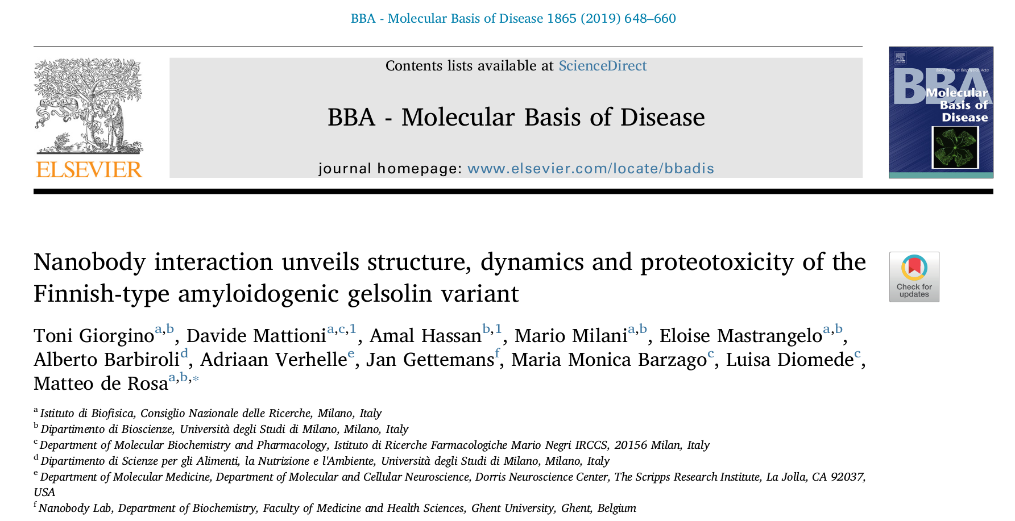
Giorgino T, Mattioni D, Hassan A, Milani M, Mastrangelo E, Barbiroli A, et al. Nanobody interaction unveils structure, dynamics and proteotoxicity of the Finnish-type amyloidogenic gelsolin variant. Biochimica et Biophysica Acta (BBA) - Molecular Basis of Disease. 2019 Mar 1;1865(3):648–60.
Journal link. Preprint.

Slide 4
Part I.
Gelsolin

Slide 5
Gelsolin
A poster-child for multi-domain proteins
Ubiquitous in cells and plasma (different isoforms)
6 repeats of the Gelsolin domain, G1-G6
Binds and caps actin filaments when activated
Activated/open by Ca⁺⁺, otherwise inactive/closed
G5
G3
G1
G4
G6
G2
Robinson et al., Cytoskeleton, 2013
PDB: 3FFN

Slide 6
G1
G2
G3
G4
G5
G6
No Ca²⁺. Closed form.
Resolved (2008).
Inactive
~ 100 Å
PDB: 3FFN
?
~ mM Ca²⁺. Active form.
Dynamic. Elusive.
1
?
6
Active
2
?
However, crystallisation of Ca²⁺-bound isolated domains has been successful.

Slide 7
Domain G2 and
AGel Amyloidosys

Slide 8
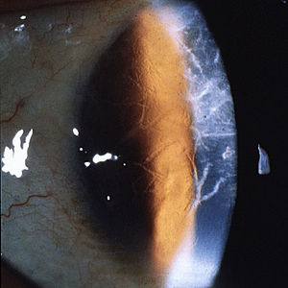
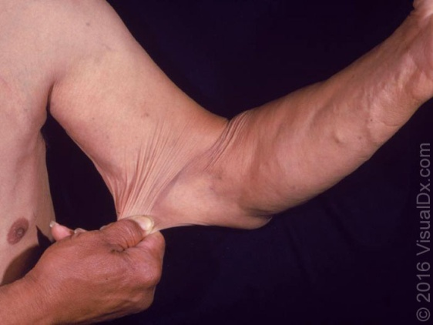
AGel amyloidosis
Also known as…
FAMILIAL Am., FINNISH TYPE Am. V Am., MERETOJA TYPE Am. CRANIAL NEUROPATHY WITH LATTICE CORNEAL DYSTROPHY Am. DUE TO MUTANT GELSOLIN HEREDITARY GELSOLIN Am.
& permutations
“AGel amyloidosis is a rare, usually systemic amyloidosis characterized by a triad of ophthalmologic, neurologic and dermatologic findings due to the deposition of gelsolin amyloid fibrils in these tissues”.
Corneal lattice dystrophy
Rare, but endemic in Finland
“… was 1/1,040 among 182,000 inhabitants, whereas in 1860 in the parish Valkeala the prevalence was calculated at 1/155. Today the true prevalence probably lies between these figures.” (Meretoja 1973)
Inherited, autosomal dominant
Caused by GSN gene mutations
No cure, just symptomatic treatments
Cutis laxa

Slide 9
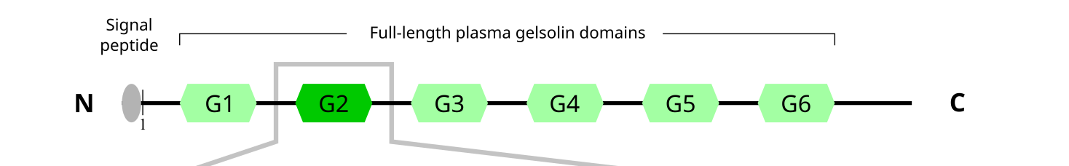
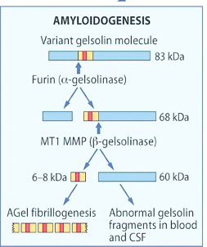

Mutations causing Agel
D187N Systemic, Finnish
D187Y Systemic, Danish
G167R Renal
N184K Renal
All in G2 domain
WT plasma GSN encounters furin without consequence since WT is correctly folded.
Mutant plasma GSN has a structural intermediate state exposing the cleavage site, and undergoes pathological furin processing.

Slide 10


C-terminus
Gelsolin G2 WT
2002 Cd²⁺ 1KCQ 2019 Ca²⁺ 6QW3
Ca⁺⁺
Agel
Mutations
Furin cleavage site
C
A
B
E
D
N-terminus

Slide 11
Mutant | Structure | Year | Disease form
WT | 1KCQ | 2002 | Sporadic
N184K | 5FAF | 2015 | Renal (rare)
G167R | 5O2Z | 2017 | Renal (rare)
D187N | ??? |  | Systemic, Finnish
D187Y | ??? |  | Systemic, Danish
Observation: D187X mutants lose Ca²⁺ coordination
Hypothesis: Is this indication of an order-disorder shift?
Support for the hypothesis:
Inability to crystallize
GSN NMR data *
Known Ca²⁺-regulated disorder/order transitions: sortase, a-cyc toxin, etc.
Thermodynamic stabilities§ : WT ≠ mutant
* Kazmirski et al. Nat Struct Mol Biol. 2002 Feb;9(2):112
§ Thermal and chemical

Slide 12
Llamas
Nanobodies to the rescue

Slide 13
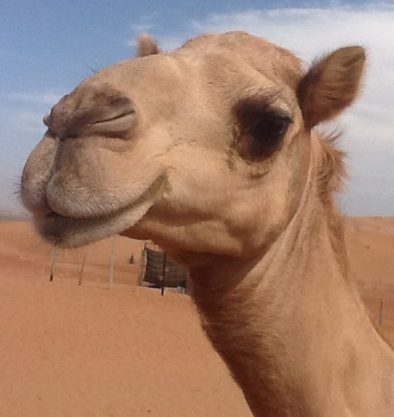

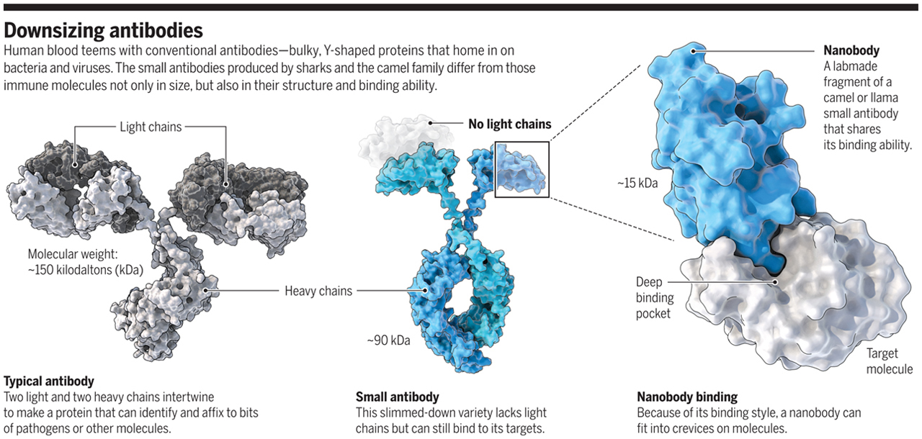
Nanobodies
VHH, variable domain of hcAbs ~15 kDa
doi:10.1126/science.360.6389.594
Notes:
Camelids, including llamas and alpacas, are endowed with a unique immune system that encompasses heavy chain only antibodies, in addition to regular 4-chain antibodies. VHHs or nanobodies as they are called, correspond with the antigen binding part of heavy chain antibodies. They are only 15 kDa in size, 10x smaller than a conventional antibody. Camelid nanobodies are a powerful research tool to study protein function in nearly every biological background: in vitro, in cells or in organisms.

Slide 14
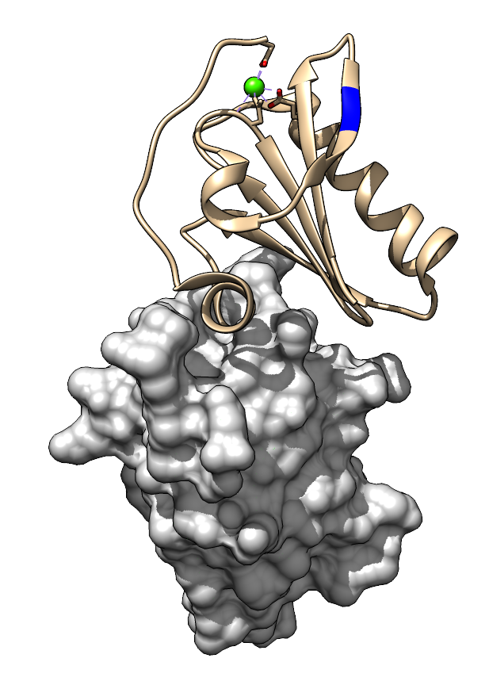
2015: Gettemans et al. – G2 Nanobodies
Inoculate llamas with GSN WT G2
Extract nanobodies (Nb11)
Sequence them
Obtain WT:Nb structure
Idea
Can the WT-raised Nb11 re-stabilize D187N enough to allow crystallization?
PDB: 4S10
Van Overbeke et al., HMG 2015

Slide 15
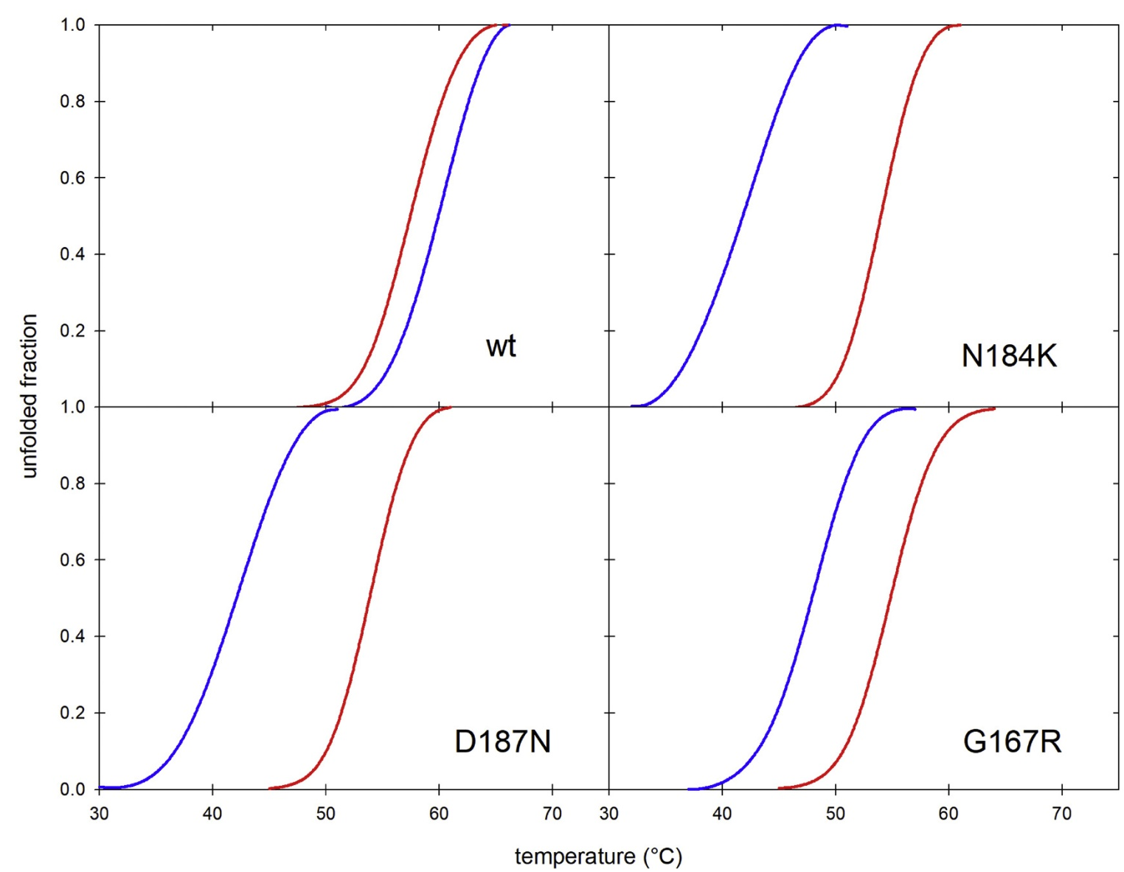
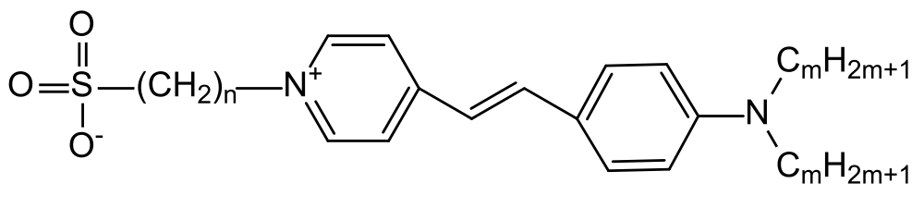
Does Nb11 increase stability?
→ Thermofluor (differential scanning fluorimetry) experiments: measure the temperature exposing the hydrophobic core.
Mutants are destabilized
Nb11-binding re-stabilizes them
SYPRO Orange binds nonspecifically to hydrophobic surfaces, and water strongly quenches its fluorescence. When the protein unfolds, the exposed hydrophobic surfaces bind the dye, resulting in an increase in fluorescence by excluding water.
Giorgino et al., BBA MBD, 2019

Slide 16
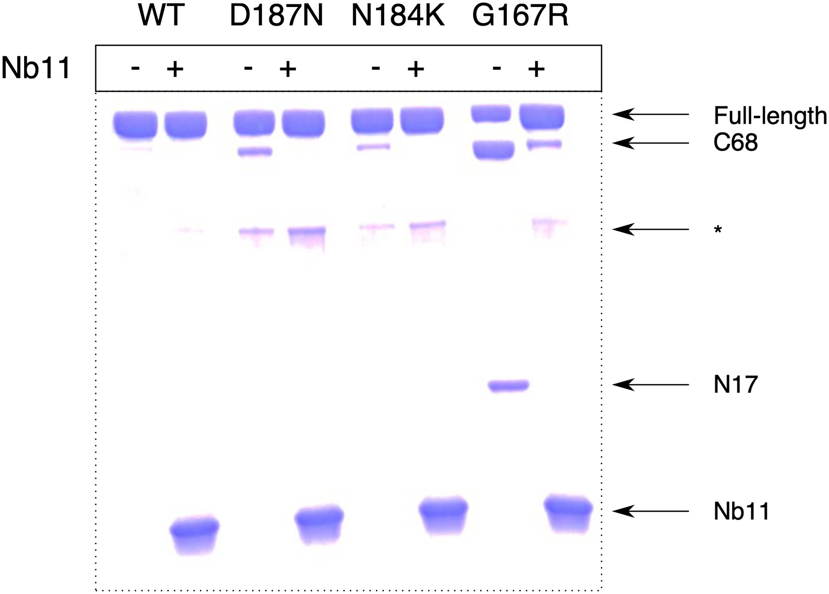
Does Nb11 protect from proteolysis?
→ Furin proteolysis experiments
Mutants are cleaved
Nb11-binding protects them
C68 and N17 (kDa) are the two fragments produced by furin activity.
Giorgino et al., BBA MBD, 2019

Slide 17
G2 + Nb → structure

Slide 18
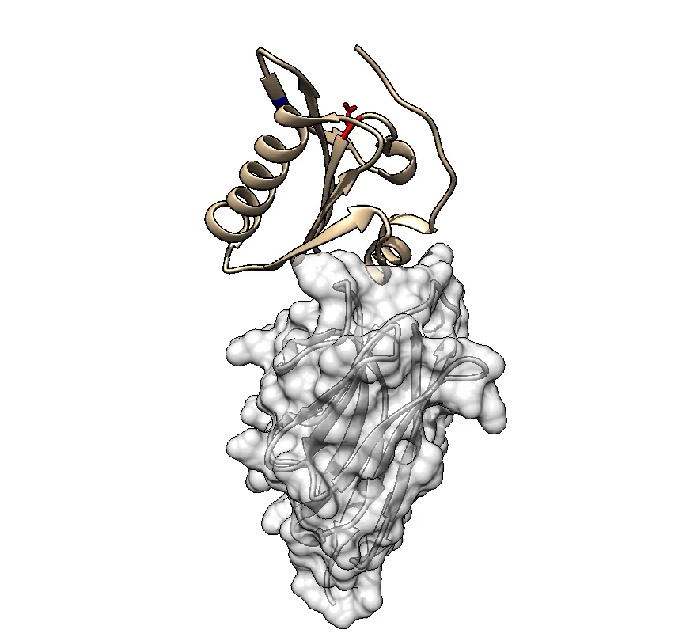
Does Nb11 enable crystallization of D187N?
Yes, it does.
6H1F, 1.9 Å
Red: D187N mutation
Blue: furin cleavage site
Ca++ is missing
Yet C-terminal tail in place.
G2 D187N
Stabilizing Nb11
Giorgino et al., BBA MBD, 2019

Slide 19
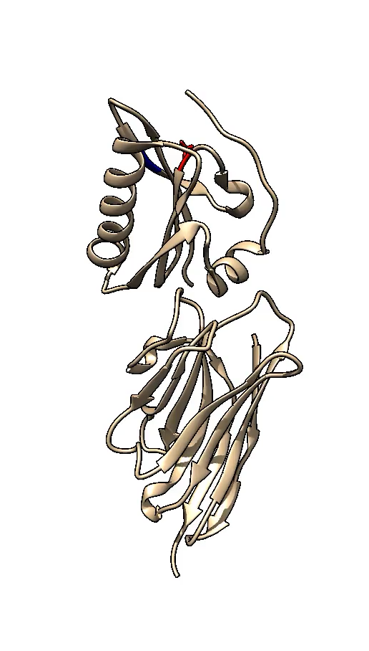
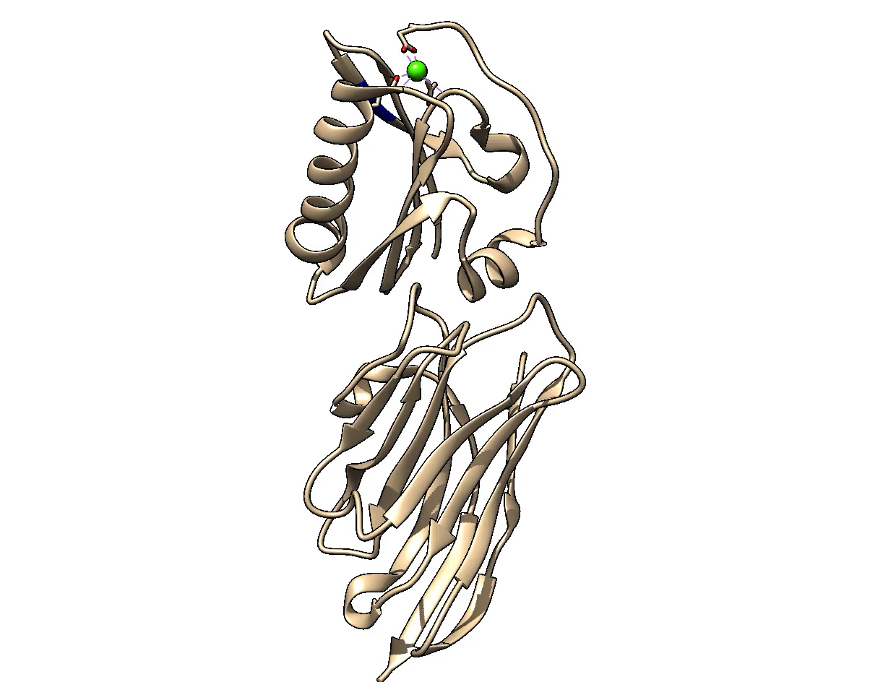
Three puzzles!
WT:Nb11 complex compared to D187N:Nb11.
WT and D187N are virtually identical*: same structure, different function
Nb11 binds far from the furin cleavage site…
…and far from the Ca²⁺ ion
* Except Ca²⁺ binding
WT: 4S10, 2.6 Å
D187N: 6H1F, 1.9 Å

Slide 20
G2 + Nb → modulation of the conformational ensemble

Slide 21
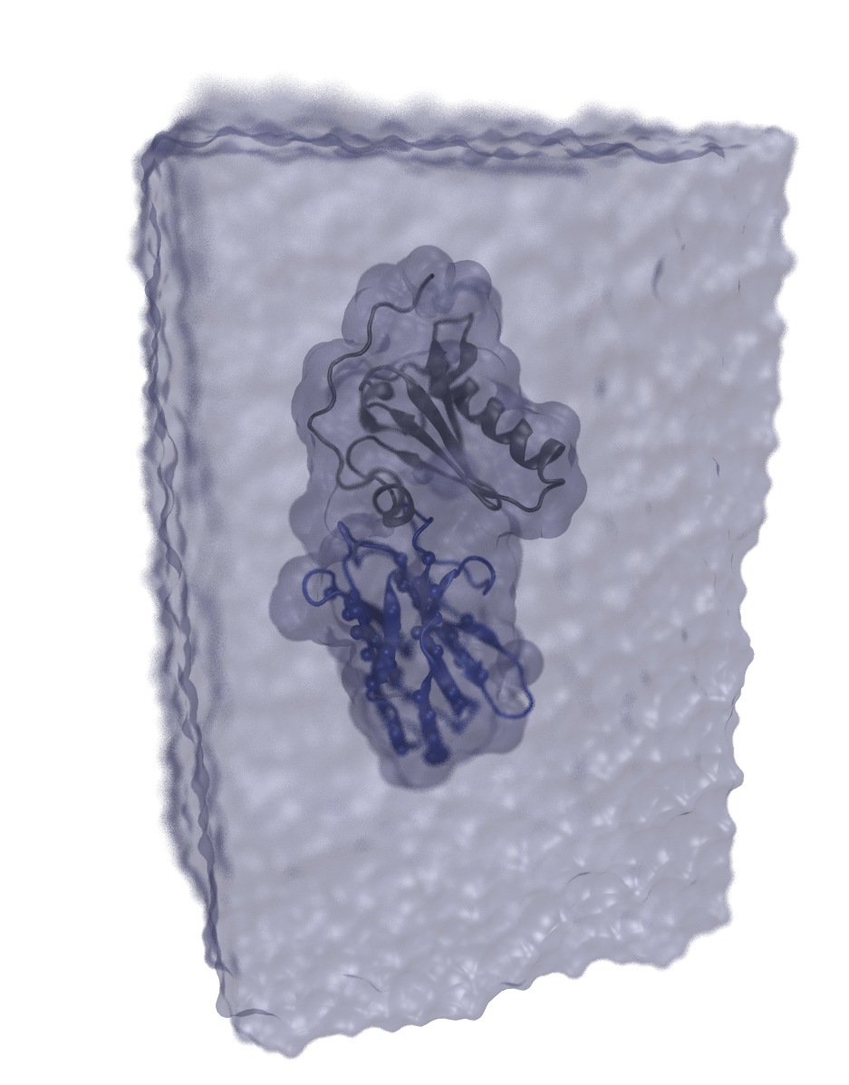
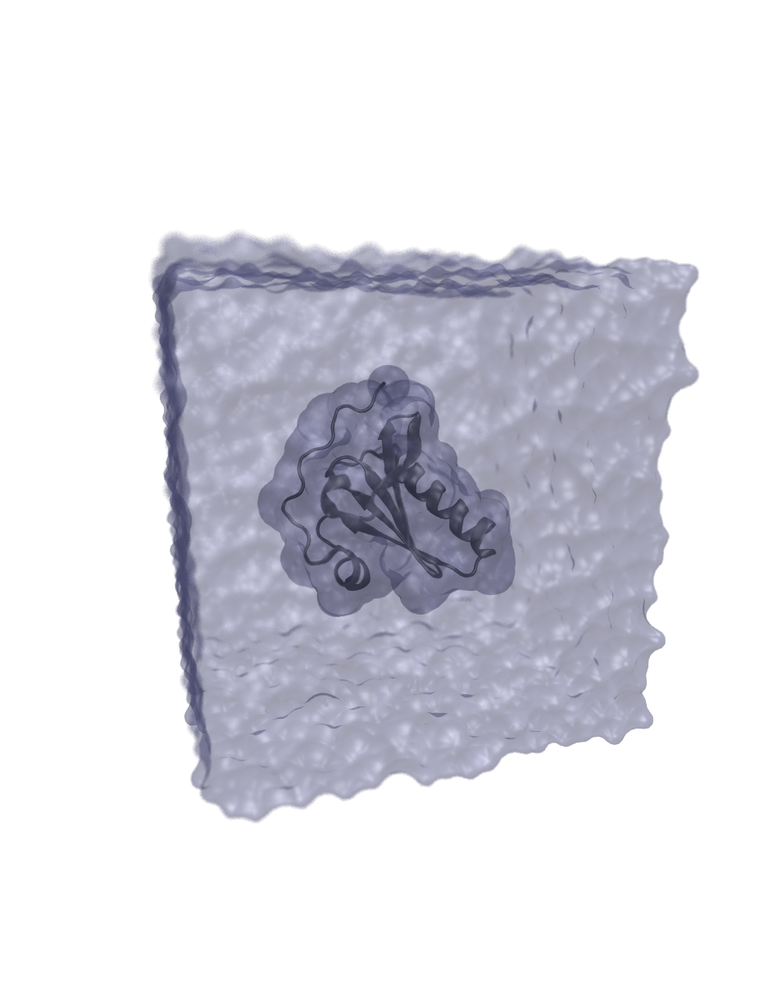
GSN ± Nb11 MD simulations
Unbiased sampling @300 °K CHARMM36
100 mM NaCl ~3 μs tot. ~25k/43k atoms
Harmonic restraints: SS Nb1 @ 0.03 kcal/mol/Å²
15 Å buffer
105 Å
(65 Å) ³
62 Å
67 Å

Slide 22
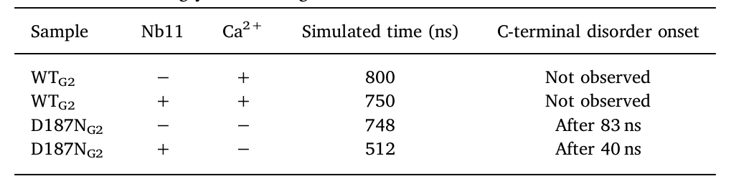
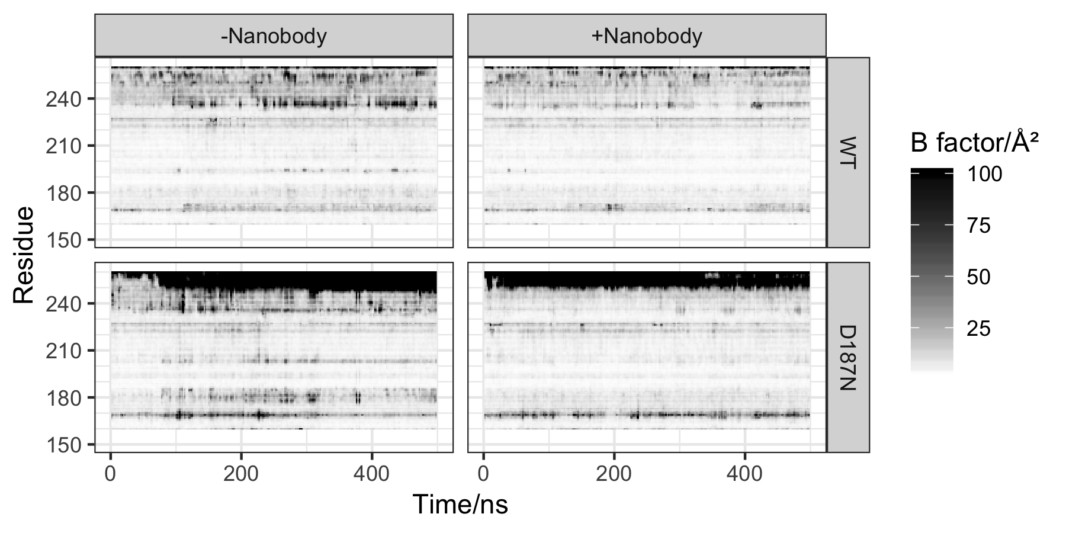
MD results
α₂
α₀

Slide 23
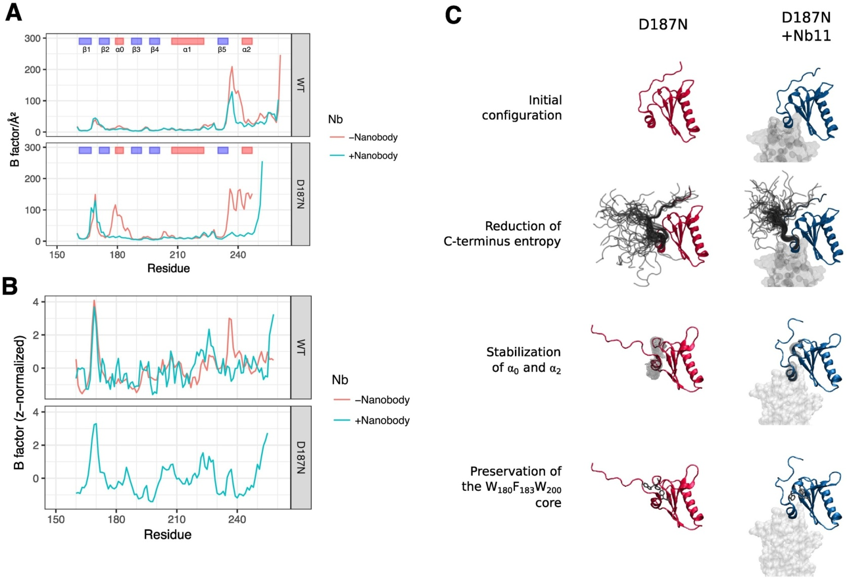
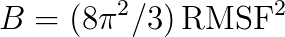

A matter of dynamics?
WT: Nb11 has ~ no effect on fluctuation profile (control)
Mutant: destabilized α₀, α₂
Nb11: complete stability recovery
MD vs exp. B-factors →

Slide 24
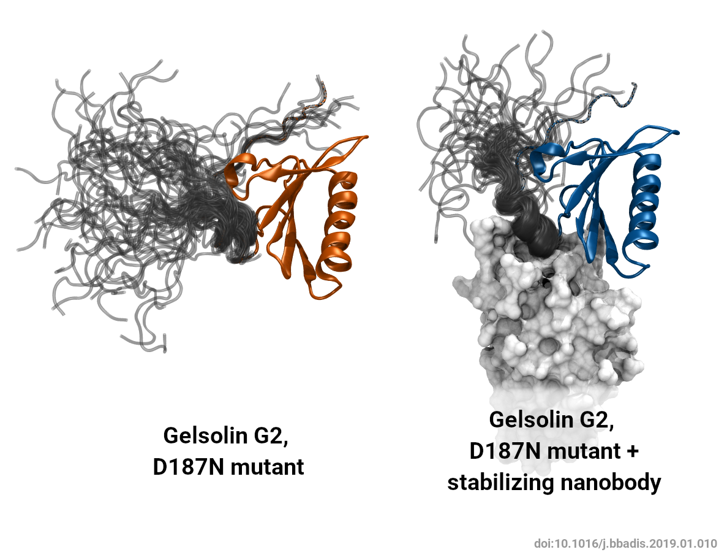
Reduction of disorder at C-terminus

Slide 25
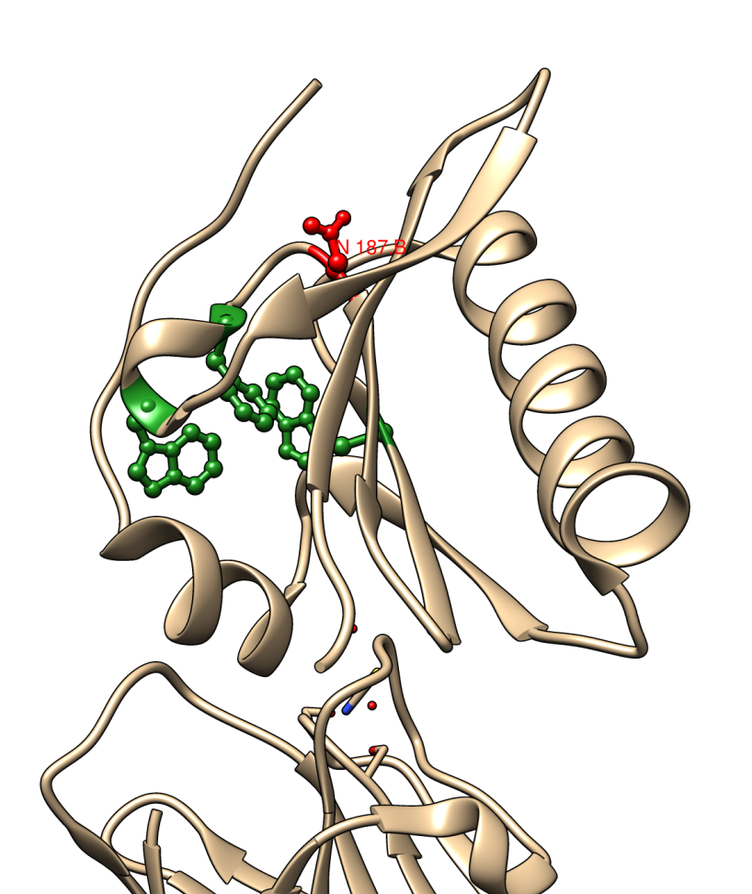

Slide 26
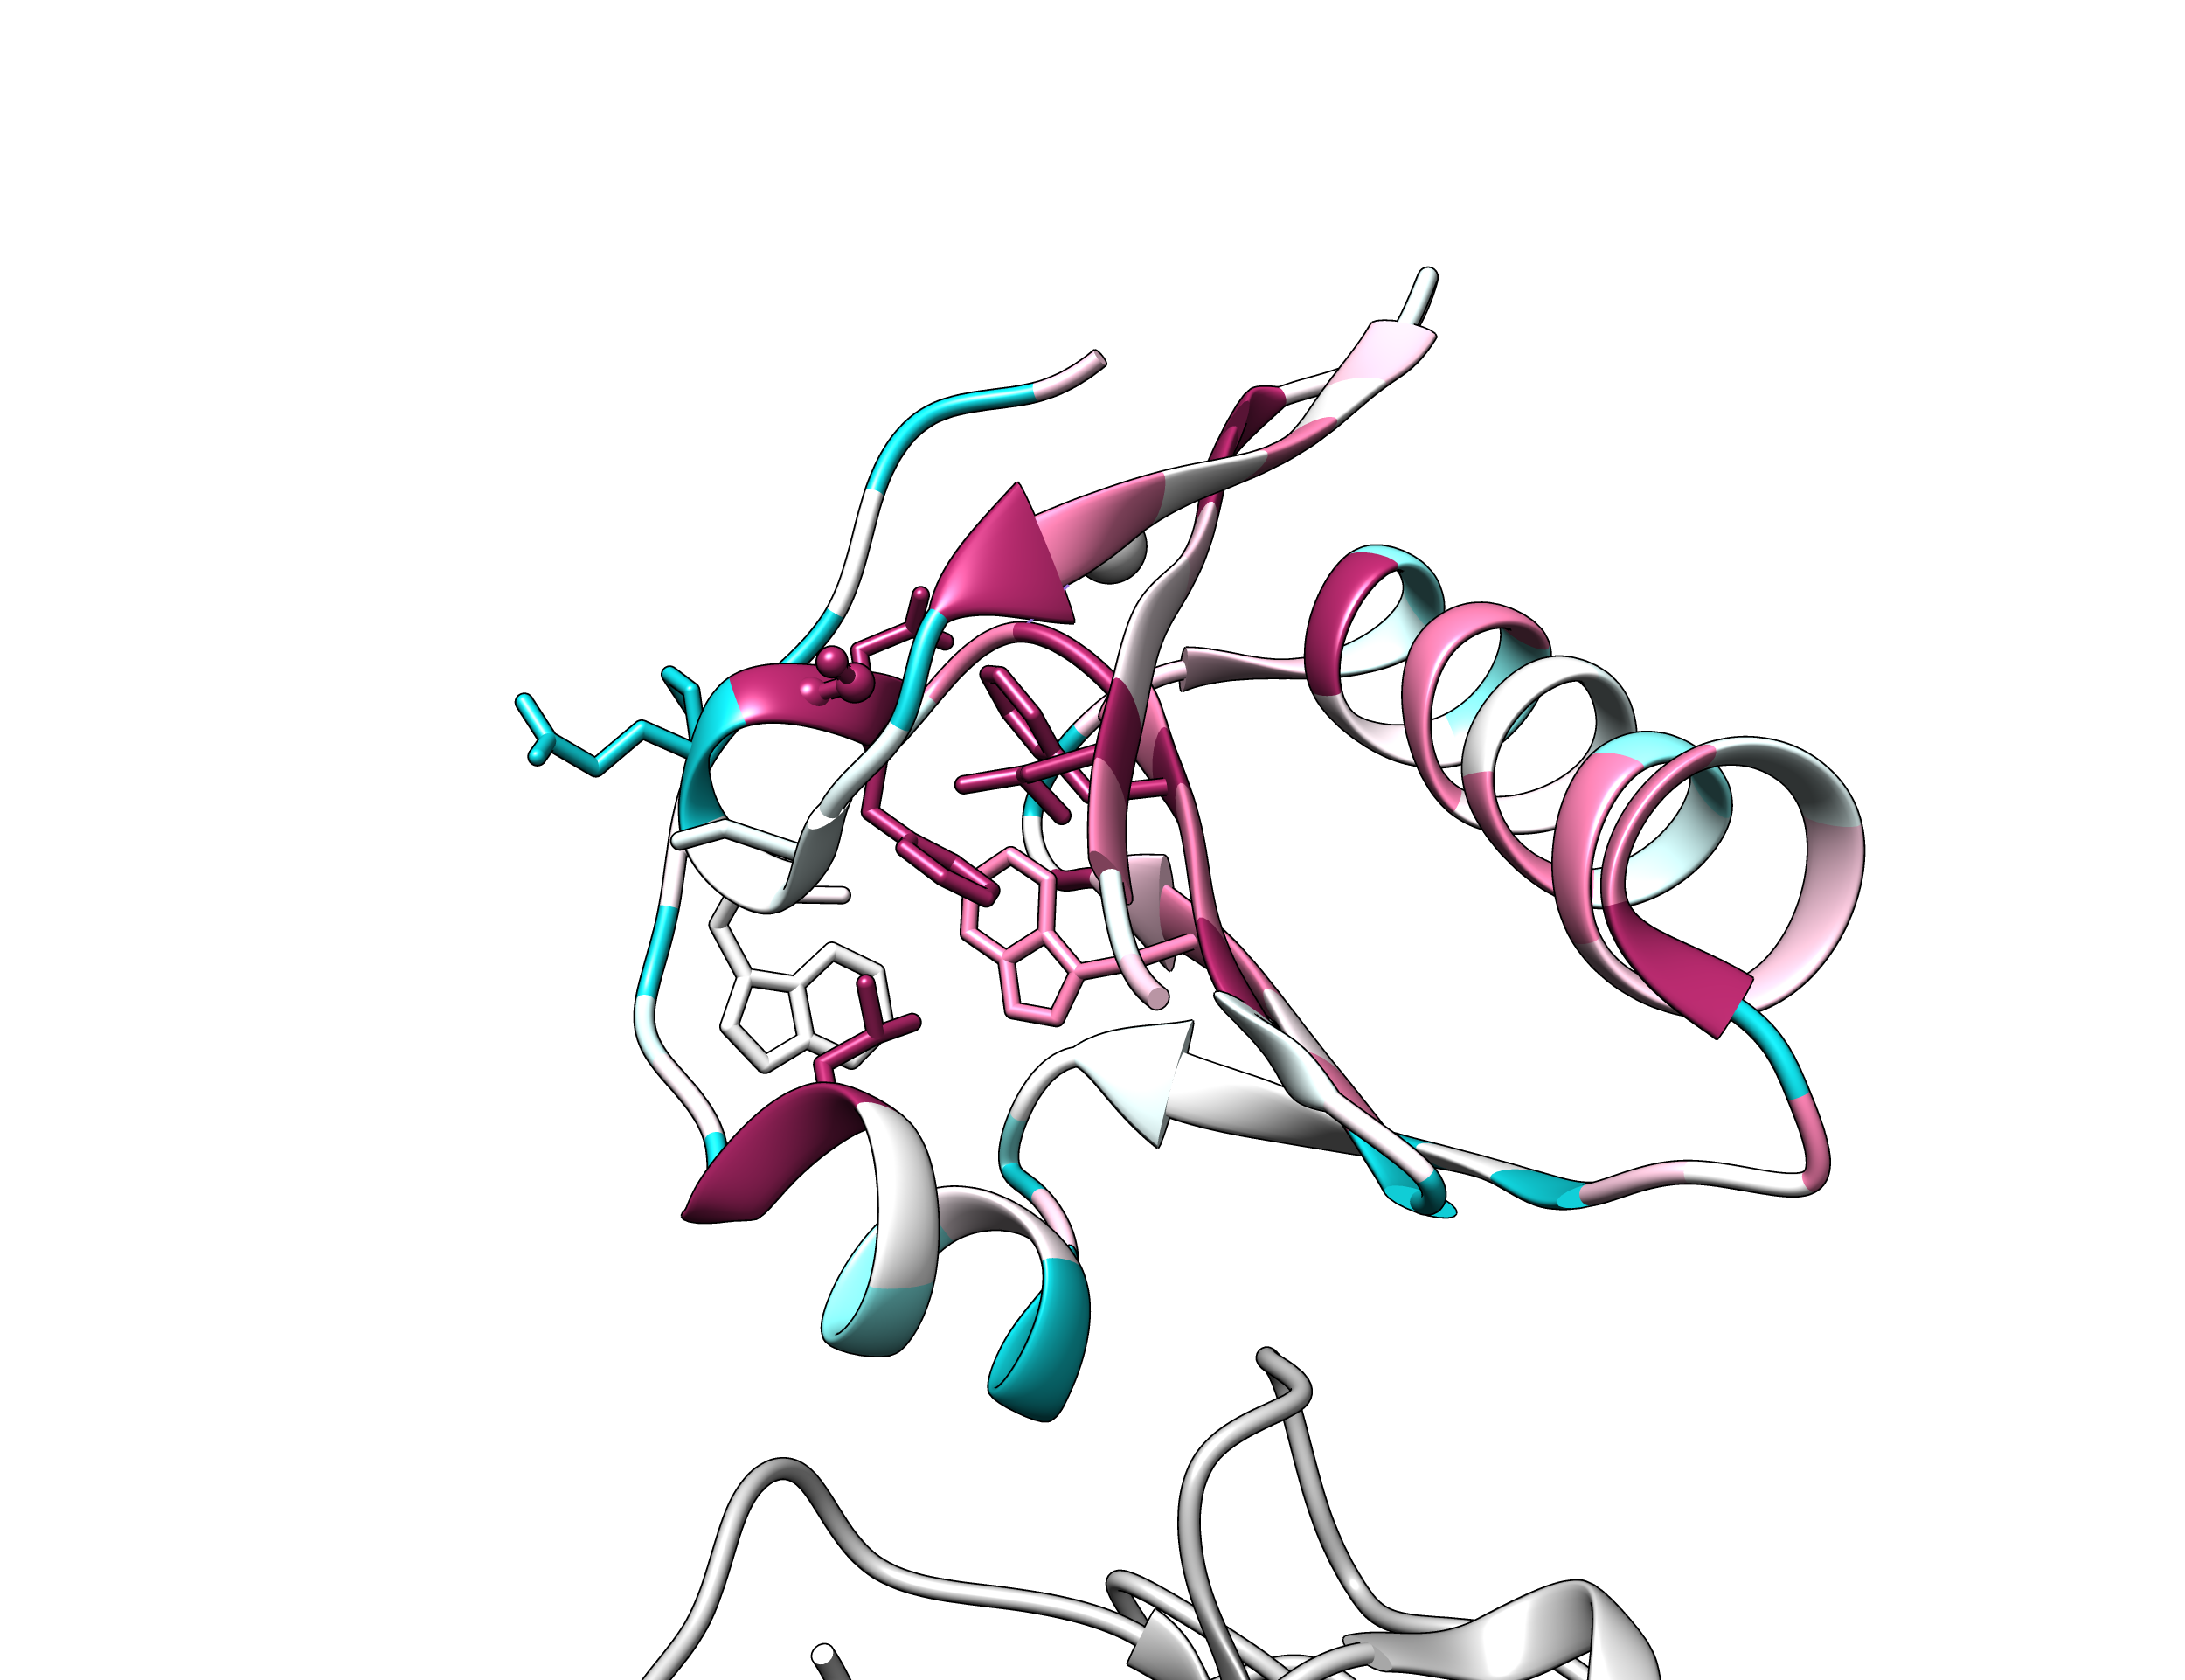
W180, F183, W200 form a conserved hydrophobic core centered ~ at F183 (α0)

Slide 27
Any chance to make a drug out of it?

Slide 28
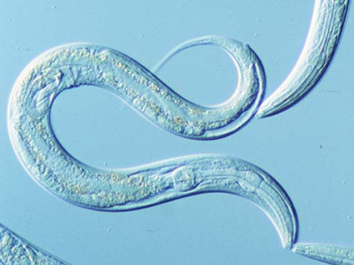
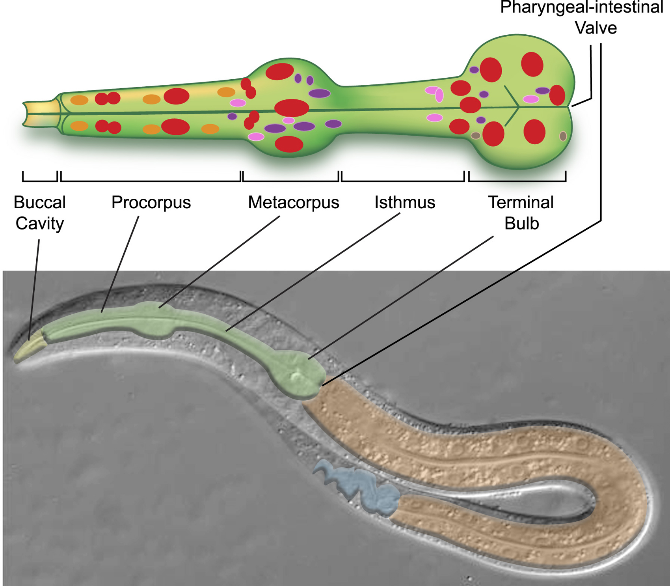

Caenorhabditis elegans
A well-behaved model organism
Transparent, relatively easy to handle
959 cells, 302 neurons
Pharynx pumps continuously, orthologous to vertebrate heart
Pharynx pumping used for toxicity assays*
* LC₅₀ ranking in C. elegans was as predictive of acute toxicity in mammals, other than rat and mouse, as LD₅₀ ranking in rat or mouse. (Hunt et al. 2017, doi:10.1002/jat.3357)

Slide 29
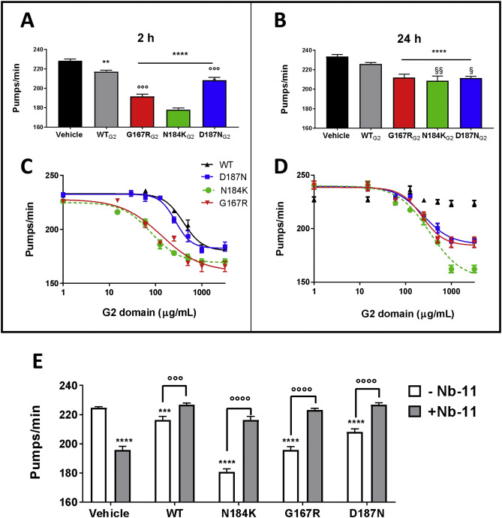
Caenorhabditis elegans
A well-behaved model organism
Transparent, relatively easy to handle
959 cells, 302 neurons
Pharynx pumps continuously, orthologous to vertebrate heart
Pharynx pumping used for toxicity assays*
G2 mutants are more toxic than WT and control
Nb11 reduces toxicity to WT levels
* LC₅₀ ranking in C. elegans was as predictive of acute toxicity in mammals, other than rat and mouse, as LD₅₀ ranking in rat or mouse. (Hunt et al. 2017, doi:10.1002/jat.3357)
Notes:
G2 domains (250 μg/ml of WT and D187N or 100 μg/ml of N184K and G167R, corresponding to 19 or 8 μM respectively) were incubated with an equimolar concentration of Nb11 (19 or 8 μM) for 10 min at room temperature under shaking conditions. Nb11 (19 or 8 μM) and G2 domains (100–250 μg/ml) alone were also administered. Vehicle (2 mM Hepes solution containing 1 mM NaCl and 0.1 mM CaCl2, pH 7.4) was used as negative control. The solutions were then administered to C. elegans (100 μl/100 worms). The pharyngeal activity was determined 2 h after treatment by determining the number of pharyngeal bulb contraction (pumps/min). Data are mean ± SE (N = 30 worms/group).

Slide 30
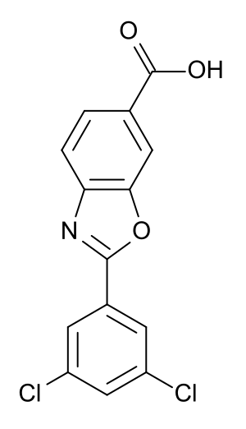
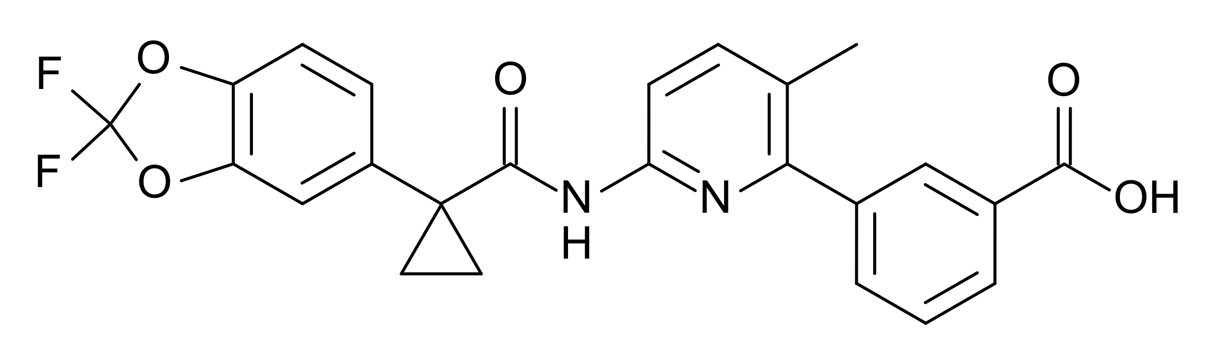
Pharmacoperones
= pharmacological chaperones
Pharmacoperones stabilize the native conformation of misfolded or destabilized proteins, to prevent their degradation and promote correct trafficking to their functional site of action.
Not many examples:
Tafamidis (Transthyretin amyloidosis): kinetically stabilizes the (mutated) tetramer, preventing monomer unfolding
Lumacaftor (Cystic fibrosis): ΔF508 point mutant in CFTR does not reach membrane and is degraded in the ER.
Cell Stress Chaperones. 1996 Jun; 1(2): 109–115.

Slide 31
Conclusions
D187N impairs G2 stability by loss of Ca²⁺, shifting balance towards disordered tail conformations
Nb11 re-stabilizes the domain fold locally protecting a conserved hydrophobic core
Mechanism obtained via combined crystallography + molecular dynamics simulations

